Slide 1
Synthetic Tests

Slide 2
Synthetic Tests
Conservative transport
Reactive transport (biogeochemistry)

Slide 3
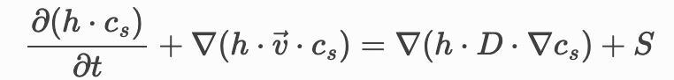
Synthetic Tests: Conservative Transport (conservative tracer)
Governing physical processes:
Pure Advection
(steady-state/uniform velocity field)
Pure Diffusion/Dispersion
(no flow)
Advection-Dispersion
(steady-state/uniform velocity field)
Domain/Media:
Free surface
River (1D)
Lake (1D-2D)
Runoff (2D)
Porous media
Soil
Snow (during melt, multi-phase)
Load type:
No load (conc = 1)
Point Instantaneous
Point Continuous
Diffuse
Combinations:
(derivation of 12 analytical solutions)

Slide 4
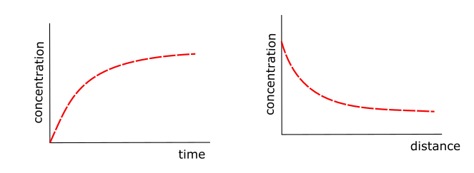
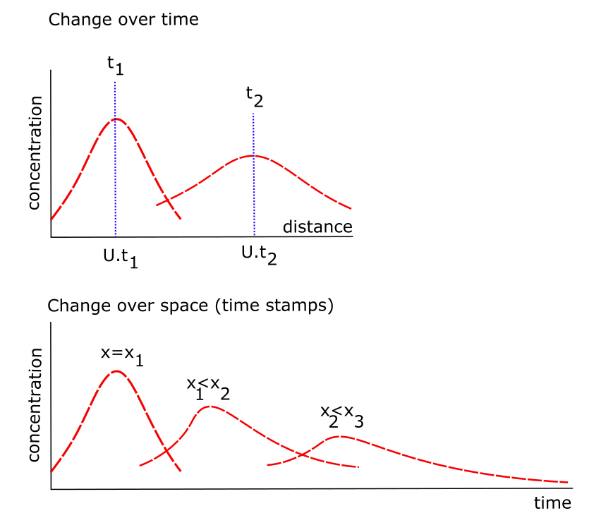
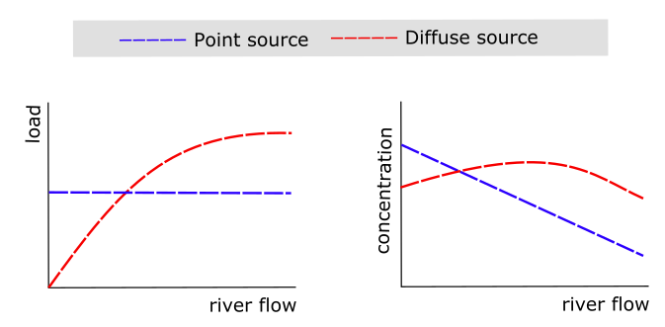
Synthetic Tests: Conservative Transport (conservative tracer) (examples of the analytical solutions)
Governing Eq: advection and dispersion
Domain/Media: free surface
Load Type: point source
Governing Eq: advection only
Domain/Media: porous media or free surface
Load Type: continuous source
Governing Eq: advection and dispersion
Domain/Media: free surface
Load Type: diffuse vs point sources

Slide 5
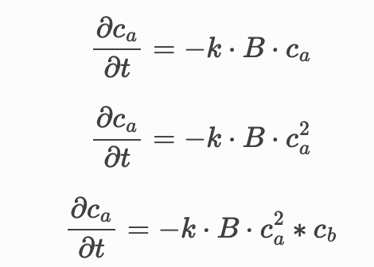
Synthetic Tests: Reactive Transport (non-conservative tracer)
Single species reactor (no flow)
1st order kinetics
(CSTR)
2nd order kinetics
(CSTR)
3rd order kinetics
(CSRT)
Multi-species reactor (no flow)
Reaction networks based on combinations of 1s, 2nd and 3 order reaction species
Single species reactor
(with steady-state/uniform flow)
Advection & Disperion (PDE)
+
1st , 2nd , and/or 3rd order kinetics
Multi-species reactor
(with steady-state/uniform flow)
Advection & Disperion (PDE)
+
Reaction networks based on combinations of 1s, 2nd and 3 order reaction species

Slide 6
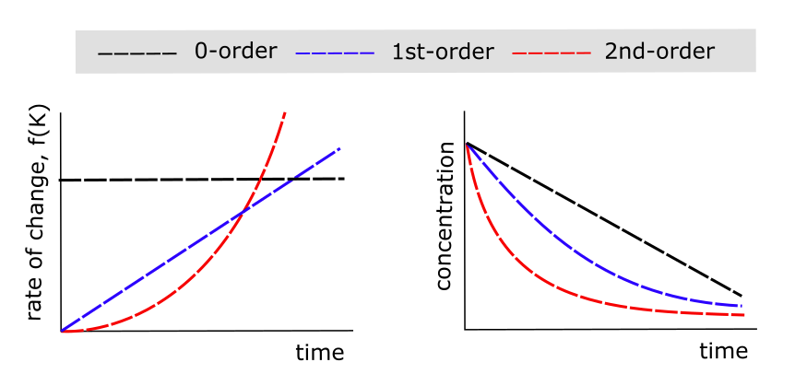
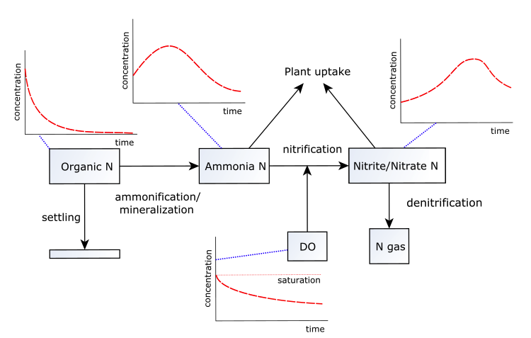
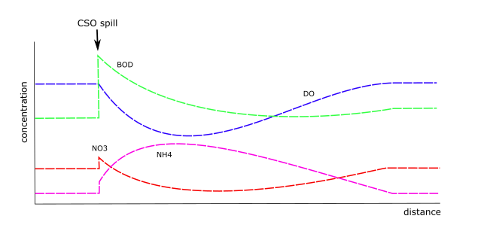
Synthetic Tests: Reactive Transport (conservative tracer) (examples of the analytical solutions)
Governing Eq: CSTR (no flow)
Domain/Media: free surface or porous media
Reactions: 1st, 2nd and 3rd order (single species)
Governing Eq: CSTR (no flow)
Domain/Media: free surface or porous media
Reactions: reaction networks
Governing Eq: advection and dispersion
Domain/Media: free surface
Load Type: Point source and reaction network

Slide 7
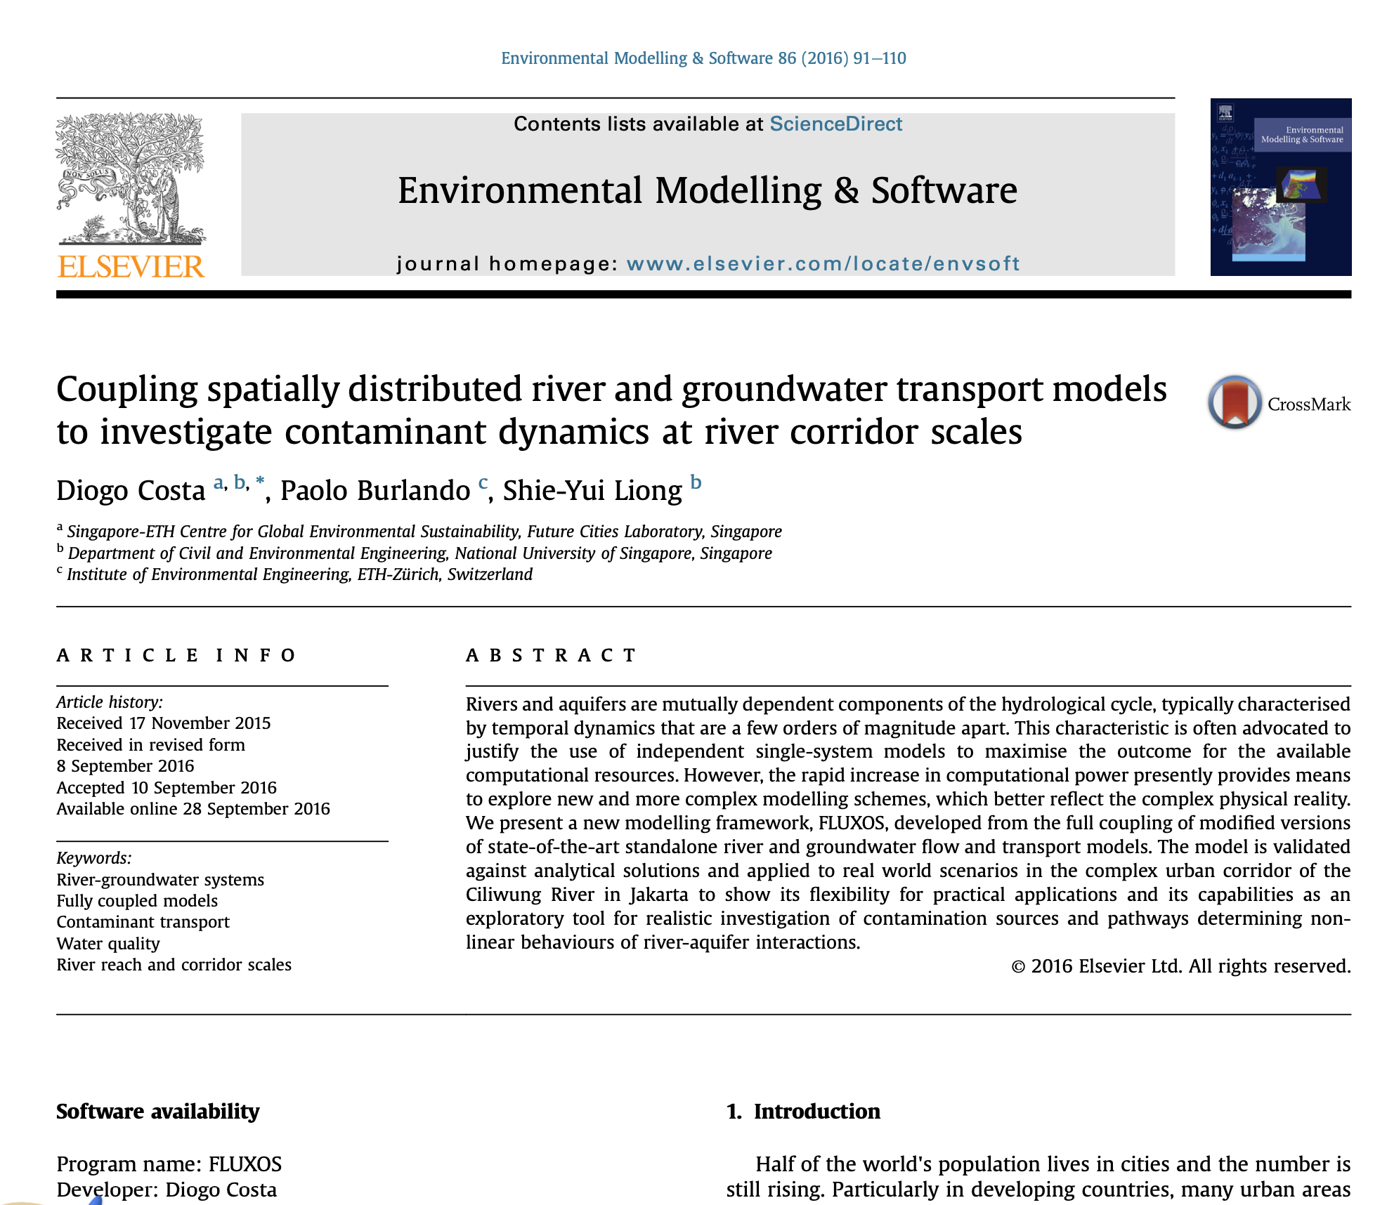
Will try to have within the next 2 weeks: (see example of my paper)
Synthetic Tests defined
3 or 4 for conservative transport
3 or 4 for reactive transport
Analytical solutions derived for each synthetic test
Prepare OpenWQ’s input files (JSON) to represent each synthetic test
Paper: write the section on Synthetic Tests

Slide 8
Synthetic Tests
4 tests for Instantaneous Point source
4 tests for Continuous point source
Diffusion source? (any analytical solution)
5 Reaction network cases (this one is much easier)

Slide 9
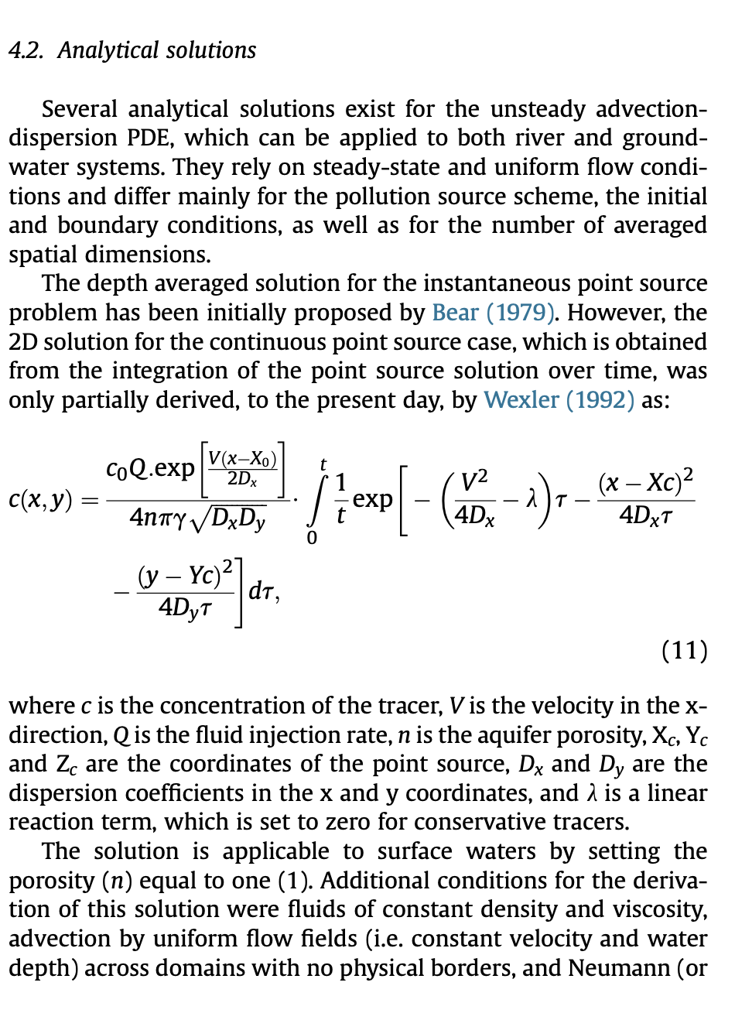
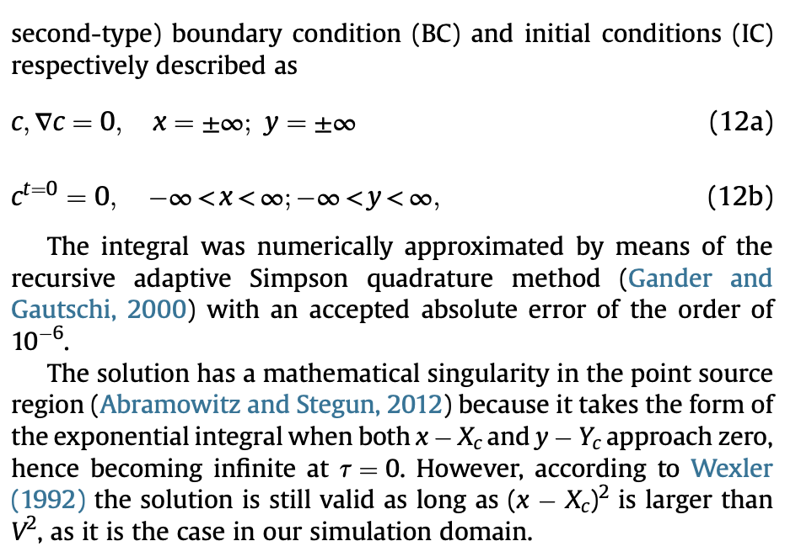
Synthetic tests 1 and 4 Instantaneous point source
From my EMS paper Analytical solution applies to both conservative and reactive tracers
Conservative (SW)
Conservative (GW)
Non-Conservative (1st order decay) (SW)
Non-Conservative (1st order decay) (GW)

Slide 10
Synthetic Tests 5 and 8 Continuous point source
Conservative (SW)
Conservative (GW)
Non-Conservative (1st order decay) (SW)
Non-Conservative (1st oder decay) (GW)
Look for appropriate analytical solutions
I THINK THAT THE matlab function AnaltSOL_STEADY_STATE.m is for a continuous point source

Slide 11
Synthetic Tests 9 and 13 Reaction kinetics
This one will be easy
Single species (1 domain)
1st order kinetics
2nd order kinetics
Multispecies
Two species (1st order reactions)
DO cycle (1st order reactions)
Street Phelps DO ?
Or derived from diagram.
N cycle (1st order reactions)
Steps for multispecies:
Decide the diagram
Define reaction kinetics for each component
Derive analytical solutions for each by combining the 1-order solution (in yellow)
Derivation of 1st order, single species: (latex)
\dfrac{\partial c_a}{\partial t} = -k c_a
\dfrac{1}{c_a} = -k \cdot \partial t
\integral{0}{t} \partial c_a = \integral {0}{t} –k \partial t
\ln c \bar{0}{t} = –k \cdot t \bar{0}{t}
\ln{c_t} – ln{c_0} = - k \Delta t
\ln{ \dfract{c_t}{c_0} } = –k \Delta t
\dfract{c_t}{c_0} = \exp{–k \Delta t}
c_t = c_0 \cdot \exp{–k \Delta t}

